Slide 1

BMI Calculator
WITH PYTHON

Slide 2
Group details:
S . Udaya Sruthi – AP21110011171
S . Sharmila _ AP21110011175
Mentor details:
Mrs . karnena Kavitha rani

Slide 3
Index:
Abstract
Introduction
Problem Statement
System Requirements
Code
Algorithm
Flow chart
Conclusion

Slide 4
Abstract:
we present the detailed development and implementation of simple BMI calculator. Awareness of Body Mass Index (BMI) can be the guide to adjust a person's lifestyle and maintain a normal healthy body. This study developed a BMI calculator code that automatically calculates BMI value, displays the nutritional status and suggests ideal weight.

Slide 5
Introduction:
BMI is a measure of relative weight based on an individual’s mass and height. Today, Body Mass Index is commonly used to classify people as underweight, overweight, and even with obesity. Also, it is adopted by countries to promote healthy eating.
BMI can be considered as an alternative for direct measurements of body fat. Besides, BMI is an inexpensive and easy-to-perform method of screening for weight classes that may cause health problems.
The body mass index is calculated by dividing an individual’s weight in kilograms by their height in meters, then dividing the answer again by their height. Now let’s see how to create a BMI calculator with Python

Slide 6
Problem Statement
Body Mass Index (BMI) is a person’s weight in kilograms divided by the square of height in centimetres A high BMI can indicate high body fatness. BMI screens for weight categories that may lead to health problems, but it does not diagnose the body fatness or health of an individual person.

Slide 7
System Requirements:
SOFTWARE REQUIREMENTS:
Operating System: Windows10 and above.
Language used: Python language.
Compilers: Python ID
HARDWARE REQUIREMENTS:
Processor: 10th Gen intel core i5 and above
RAM: 4GB and above
HDD/SDD: 1GB and above

Slide 8
Code:
# asking for input from the users
the_height = float(input("Enter the height in cm: "))
the_weight = float(input("Enter the weight in kg: "))
# defining a function for BMI
the_BMI = the_weight / (the_height/100)**2
# printing the BMI
print("Your Body Mass Index is", the_BMI)
# using the if-elif-else conditions
if the_BMI <= 18.5:

Slide 9
Code:
print("Oops! You are underweight.")
elif the_BMI <= 24.9:
print("Awesome! You are healthy.")
elif the_BMI <= 29.9:
the_print("Eee! You are over weight.")
else:
print(”You are obese.")

Slide 10
Algorithm:
# asking for input from the users
the_height = float(input("Enter the height in cm: "))
the_weight = float(input("Enter the weight in kg: "))
# defining a function for BMI the_BMI = the_weight / (HEIGHT)**2
#Converting the height from centimeters to meters height=height/100
# printing the BMI print("Your Body Mass Index is", the_BMI)

Slide 11
Algorithm:
# using the if-elif-else conditions if the_BMI <= 18.5:
print ("you are underweight")
print ("your diet plan should contain", list1)
elif the_BMI <= 24.9:
elif (bmi >= 18.5 and bmi < 24.9):
print ("Healthy, you are doing good job keep going on add some more physical activity to make yourself good")
elif the_BMI <= 29.9:
print ("you are overweight")
print ("your diet plan should contain", list2)
else:
print ("Suffering from Obesity")
print ("your diet plan should contain", list3)

Slide 12
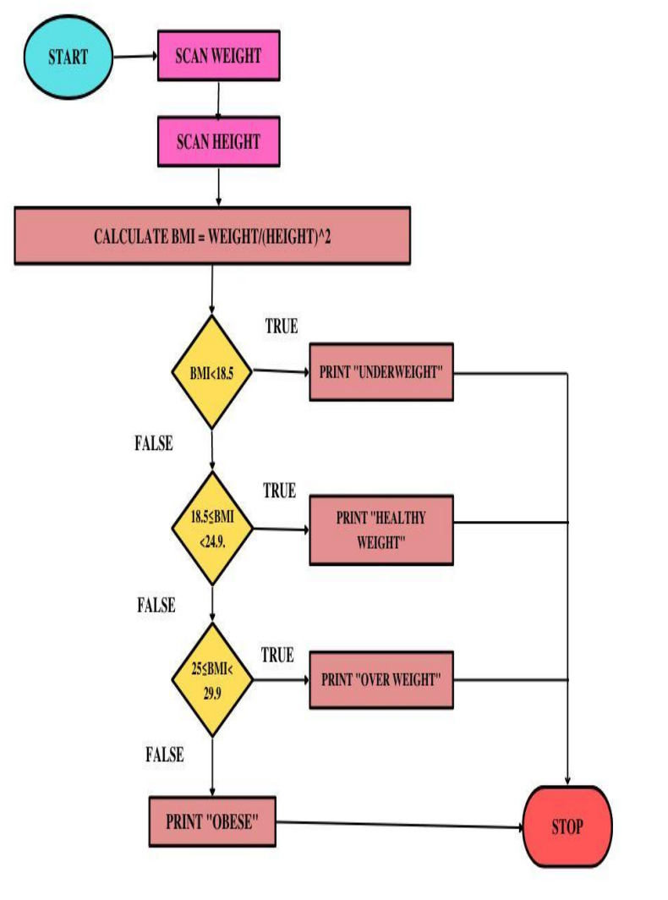
Flow chart:

Slide 13
Conclusion:
From this project, we have learnt about methods, functions and files in python. BMI is a useful indicator of health at the population level. However, the distribution of fat on your body is more important that the amount, when assessing your disease risk. For this reason, your waist circumference is thought to be a better predictor of health risk than your BMI.

Slide 14

Thank you
For giving this opportunity to us.

